Slide 1
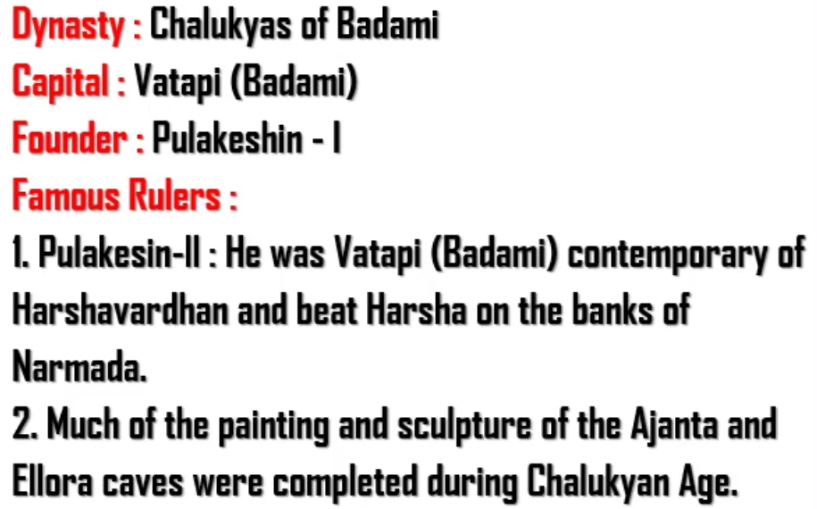
There were two types of Chalukyas:
Chalukyas of Badami (also known as Chalukyas of Vatapi)
Chalukyas of Kalyani
Rashtrakutas started building Ellora caves. But Chalukyas get the credit of finishing it.

Slide 2
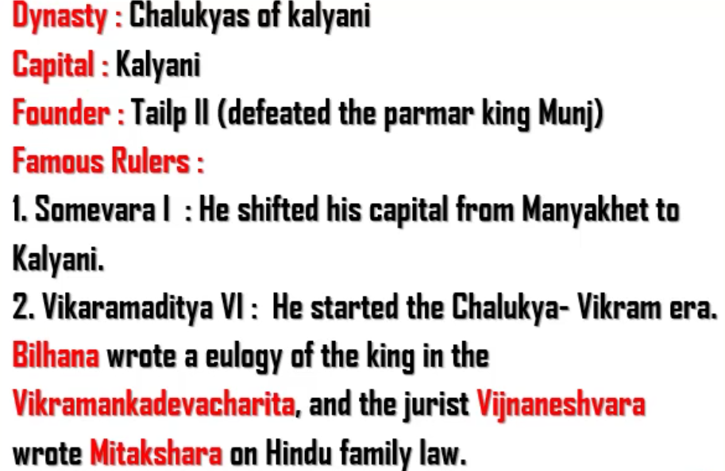
The rule of Chalukyan king, Vikramaditya – II is known as Chalukya – Vikrama era.
Eulogy – Praising the king.

Slide 3
